Slide 1
AIML Part B Clustering Employee Data
Jayden Yap Jean Hng p2112790

Slide 2
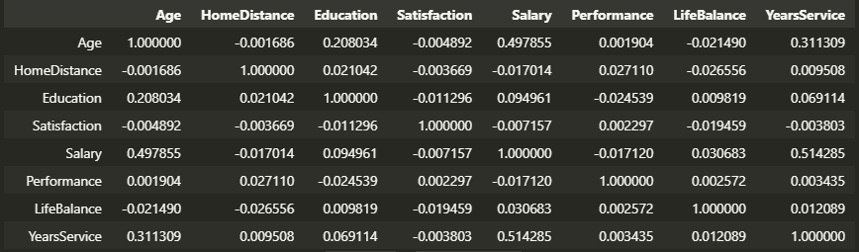
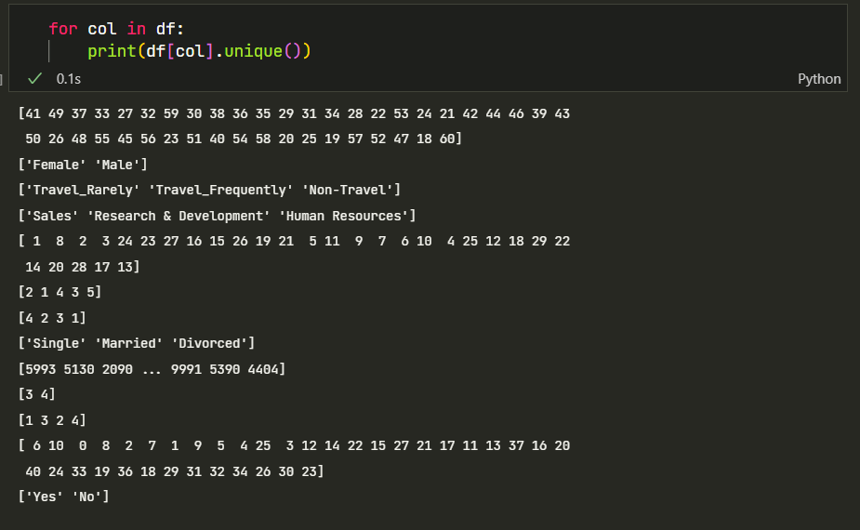
Dataset
Data of 1470 employees
13 Columns:
Numerical: Age, Home Distance, Salary, Years of Service
Ratings: Performance, Life Balance, Satisfaction, Education
Nominal: Gender, Marital Status, Resigned, Department
Ordinal: Business Travel Frequency
Unique Values
Correlations:
Education and Age are moderately correlated
Salary and Age are highly correlated
Age and Years of service are moderately correlated
Salary and Years of Service are highly correlated
everything else are weak/no correlation

Slide 3
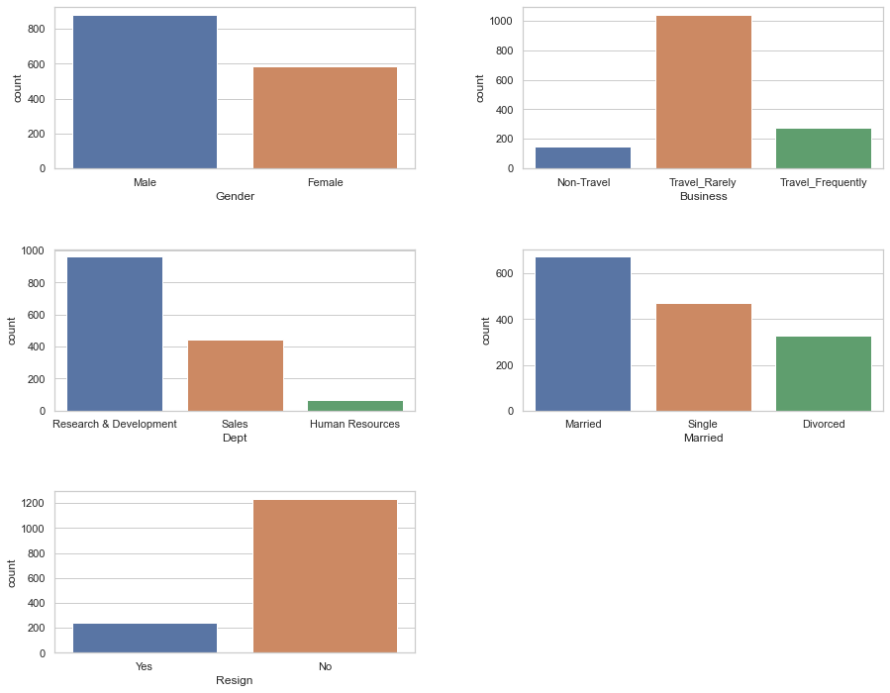
Data Visualisation
(Categorical)
~800 male employees, ~600 female employees
Most employees do business travel but only rarely
Human resources have very few employees (<100), Research & Development has almost 1000
~200 employees have resigned

Slide 4
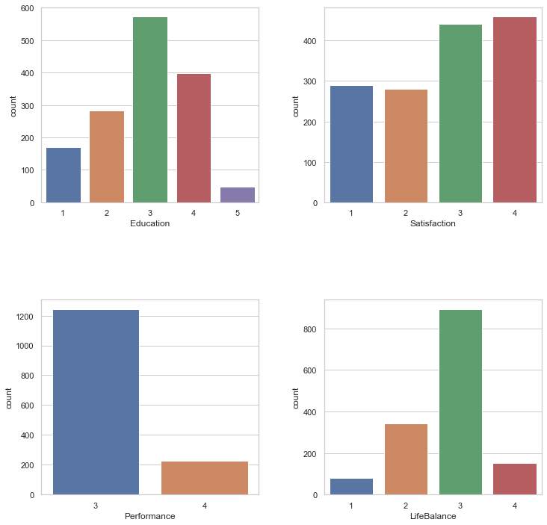
Data Visualisation
(Rating Variables)
Education has almost normal distribution
Satisfaction is above average for most employees
Performance ratings only have 3 and 4 despite 1 and 2 being available ratings too
Life Balance has majority with 3 rating, meaning they have good life and don't spend too much time working

Slide 5
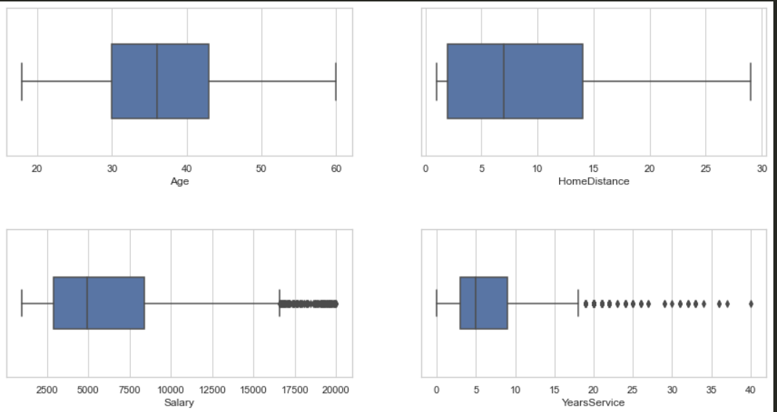
Data Visualisation
(Rating Variables)
Median age is ~36
Median home distance is 7km (dsitance between dover and chinatown)
Median salary is ~$5000, outliers with > $16000, likely executive employees
Median years of service is 5 years, only 25% of employees have <3 years of service. Has 18 outliers with more than 17 years of service, likely founders or executive employees

Slide 6
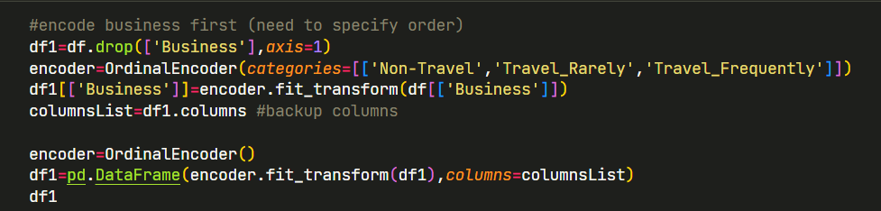
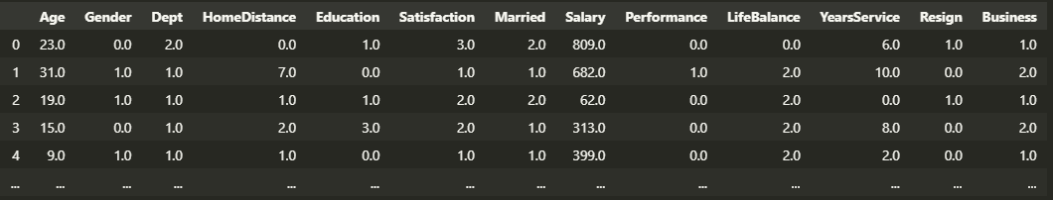
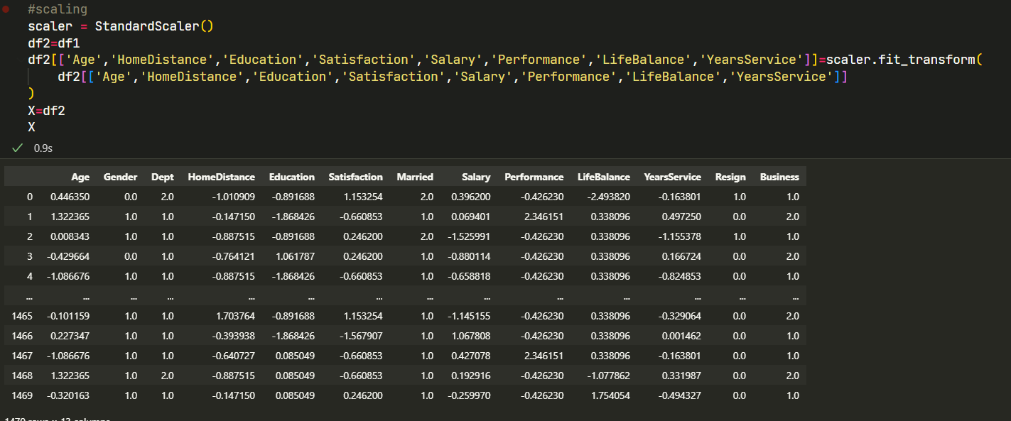
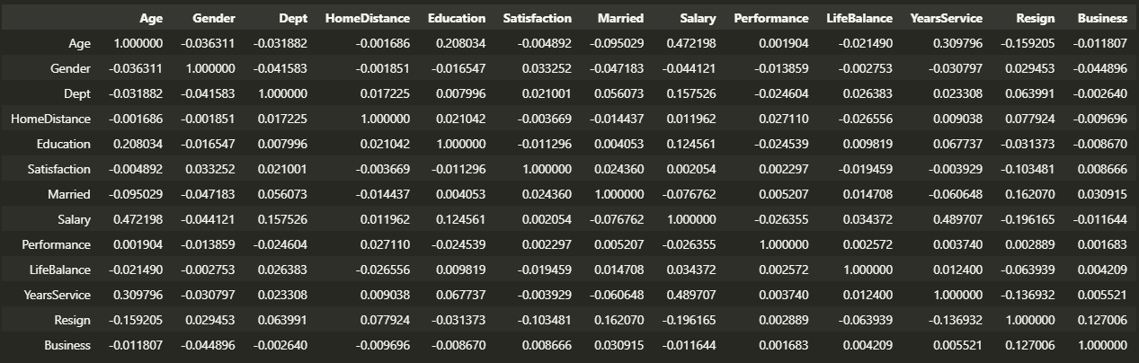
Data Processing
(Encoding)
Use Ordinal encoding to handle Categorical Data
Then use StandardScaler for the Numerical variables
New correlations:
We can see that Resign has moderate negative relationship with Salary (i.e less Salary= more Resign), same with Years of Service
Department has a moderate correlation with Salary, meaning some depeartments earn more than others

Slide 7
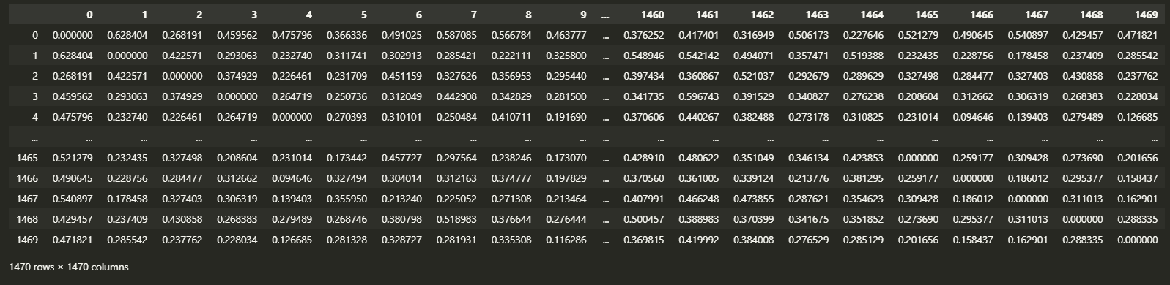
Data Processing
(Gower Distance)
I will also test the Gower's distance matrix. This is an alternative to the usual Euclidean distance used in algorithms like K Means
It should be better suited to data like this one where there is a mix of numerical and categorical data
Output is a square distance matrix (1470x1470)
Not all algorithms support it
Parameter is "metric='precomputed' "

Slide 8
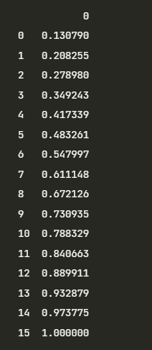
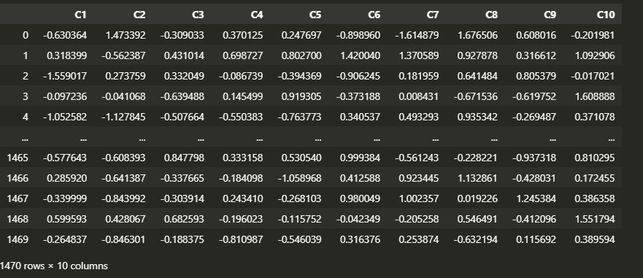
Data Processing
(FAMD)
I will also test Factor analysis of mixed data (FAMD) This is a mix of PCA and Multi Correspondence Analysis (MCA) for mixed data
<- Explained variance (intertia) for number of dimensions, to get >70%, I need 10, so I will use 10 dimensions
-> Final matrix is 10 columns
In total, will be testing FAMD, Gower distance and the Normal X data with Encoding+Scaling

Slide 9
Data Processing
(FAMD)
I will also test Factor analysis of mixed data (FAMD) This is a mix of PCA and Multi Correspondence Analysis (MCA) for mixed data
<- Explained variance (intertia) for number of dimensions, to get >70%, I need 10, so I will use 10 dimensions
-> Final matrix is 10 columns
In total, will be testing FAMD, Gower distance and the Normal X data with Encoding+Scaling

Slide 10
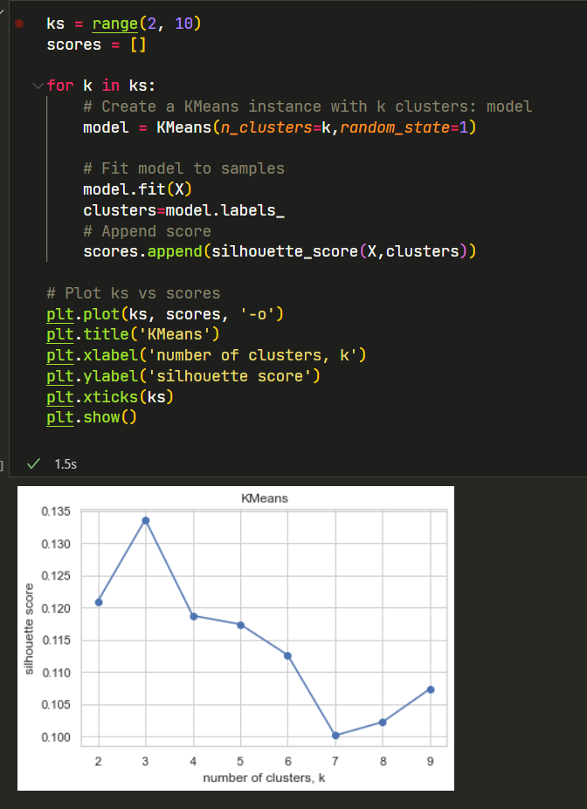
Testing Models
Tested 6 algorithms:
KMeans
Mean Shift
Spectral Clustering
Agglomerative Clustering
Birch Clustering
OPTICS
Depending on the model: I will execute:
Hyperparameter tuning: eg. Number of clusters for K means (k) to find best silhouette score
Test using those parameters to get cluster labels
Score using Silhouette Score, which is for interpretation and validation of consistency within clusters of data, higher is better
Repeat again but use FAMD / Gower data instead to see which is more suitable
Need to look at both score and interpretation of clusters, good score might not mean the results are meaningful

Slide 11
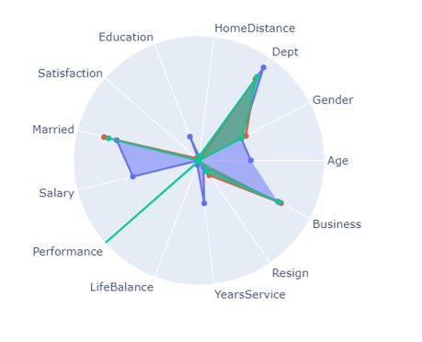
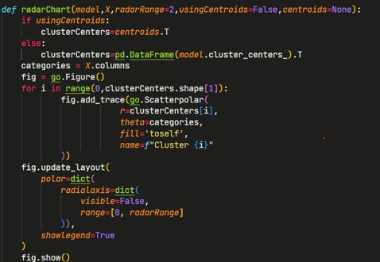
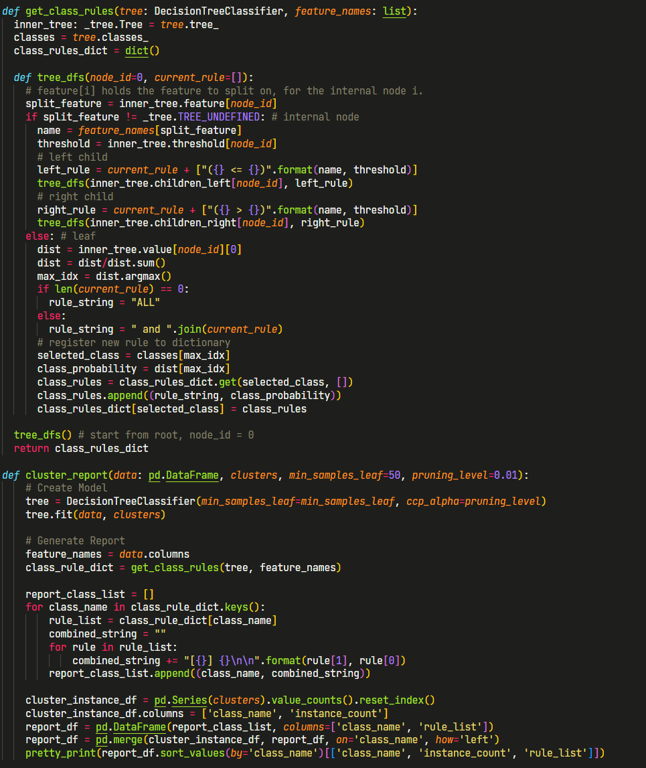
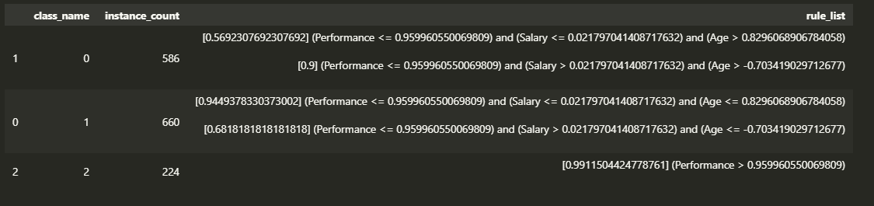
Visualisation of clusters
Radar chart function
To visualise clusters, I will use a function that creates a Radarchart using the cluster centers (centroids) to find average attributes of each cluster
To describe clusters, I will use a set of rules automatically generated by training a Decision Tree model using original features and clustering result as the label
Cluster_report function

Slide 12
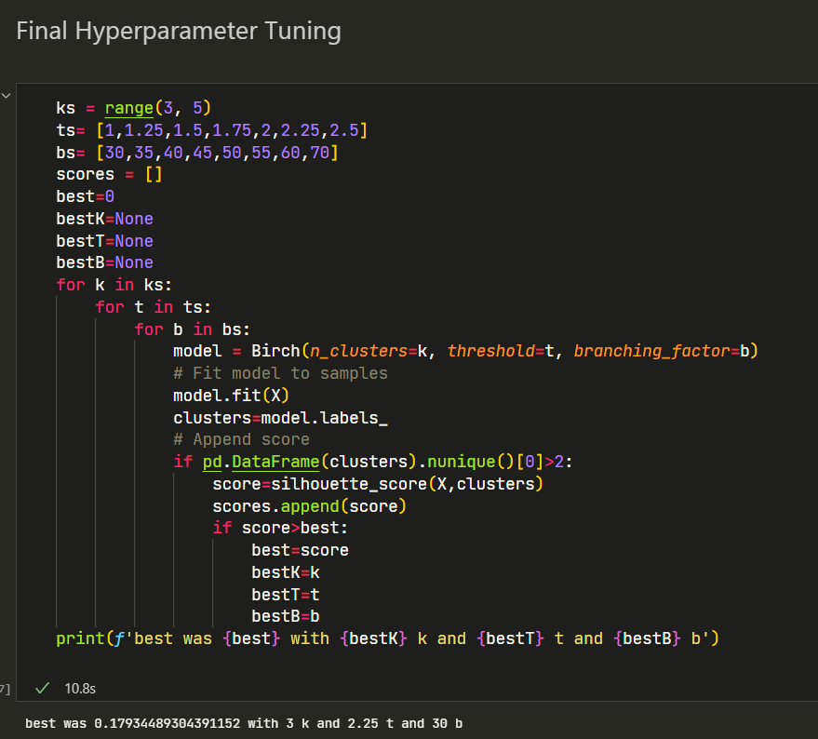
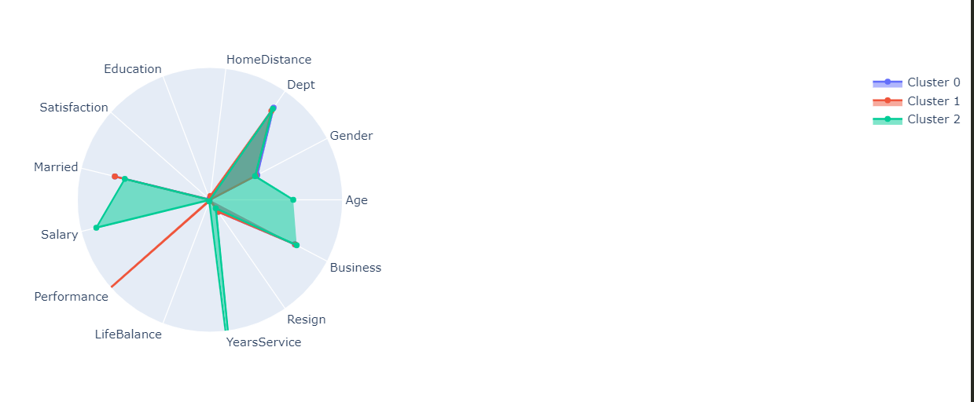
Final model
From my findings I considered Birch clustering to be the best, with a silhouette score of 0.177 with 3 clusters, it was one of the best scoring ones, it also has relatively even clusters with easy interpretation
Conducted even more hyperparameter tuning
I could only get a small improvement of 0.01
interpretation became worse and the clusters became more uneven, hence, use original model instead
Hence Best model was Birch clustering with parameters (n_clusters=3,threshold=2.25,branching_factor=30)

Slide 13
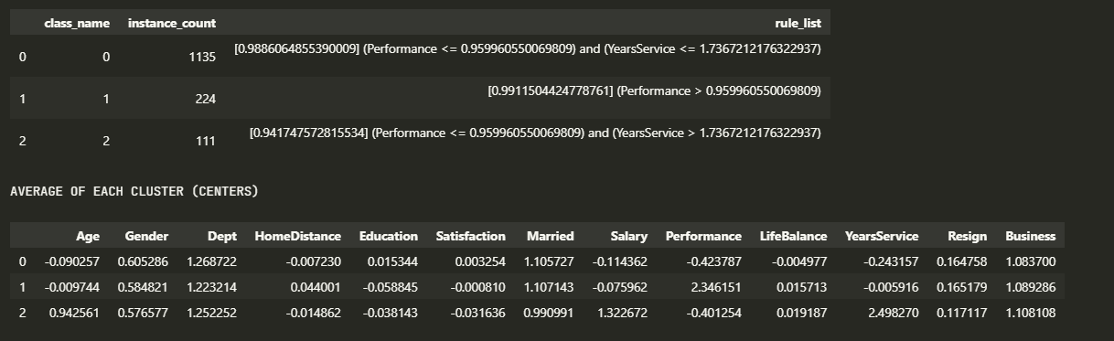
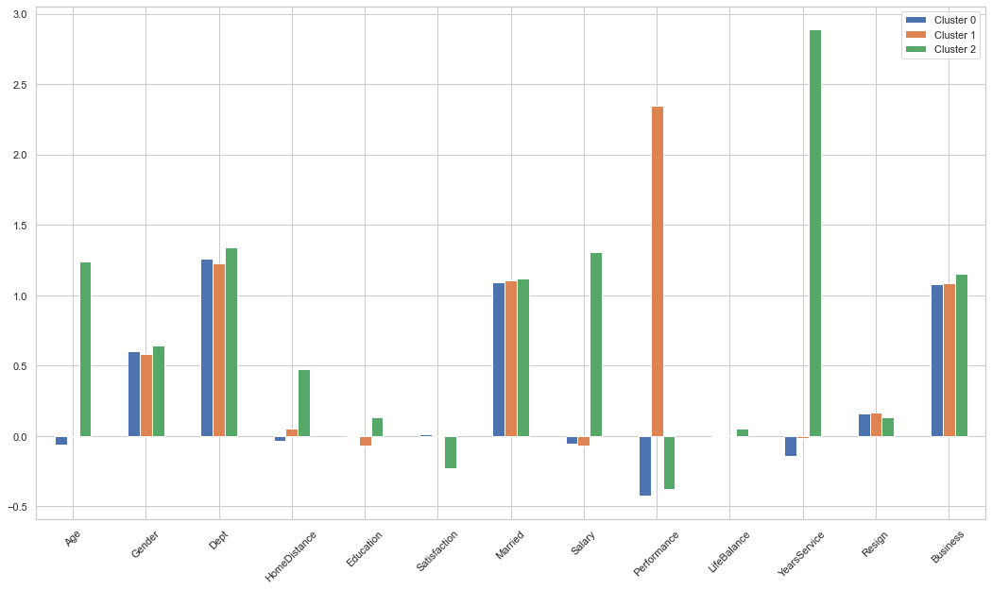
Conclusion
To answer 'Describe the characteristics of each employee cluster':
Cluster 0 consisted of average employees with no problems/outstanding qualities, in fact had lowest performance ratings (~3) but does not mean they perform bad
Cluster 1 consisted of employees with high performance but highest resignation rate, likely unhappy of not getting salary raise
Cluster 2 are the outstanding employees with high years of service, age and education, they do business travel trips the most and also get the most Salary of the 3 clusters. They have lowest resignation rate. Despite this, they actually live the furthest away from work and actually have the lowest Satisfaction rating.
To answer 'Which group of employee is the most vulnerable that the management should do something to retain them.':
I would recommend the company to increase the pay of employees with high performance rating. If they do not receive pay raise they are the most likely to resign.

Slide 14

Thank you !

